Slide 1
ESFP – 2 PROJECT NAME Waste Management System
CREATED BY:-
YASH (18162101026)
ANIL (18162101027)
HARSHVARDHAN (18162101028)

Slide 2
PROJECT INFORMATION
CREATE A CLASS WMS
STORE THE DATA IN GIVEN DATA-BASE
EX :- house no, street _ no, area/locality, city, district, state, date, waste _ type
3. void get _ data() : - store the information
void put _ data(int) :- Display to store information
4. Then display for State Name with use for switch case, for loop and if loop
5. After given condition we flow the the step.

Slide 3
Basic Idea
cout<<"1 for street no 3 and Delhi city"<<endl;
cout<<"2 for waste type is wet and quanity is 2kgs"<<endl;
cout<<"3 for houses in state Gujarat and dry type waste"<<endl;
cin>>x;
switch(x)
case 1:{
for(int i=0; i<size; i++)
{
if((strcmp(p[i].city,"Delhi"))>0)
{
if(p[i].street_no==3)
{
p[i].put_display();
}
}
}
break;
}

Slide 4
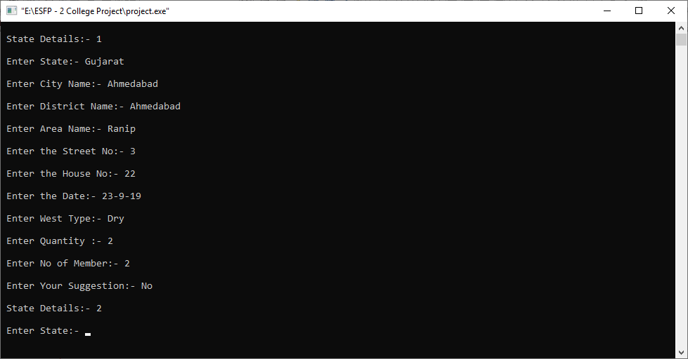

Slide 5
THANK YOU

